Slide 1
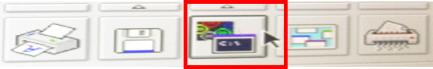
EM-5 刪除 H.D DATA LOG
EM-5 查詢 Alarm error LOG
進入DOS
[C:\] D:
[D:\] CD RTIAPPS
[D:\RTIAPPS] CD LOG
[D:\RTIAPPS\LOG]DIR/P (檢視LOG檔案大小)
[D:\RTIAPPS\LOG]DEL LOG0
[D:\RTIAPPS\LOG]EXIT
進入DOS
[C:\] D:
[D:\] CD RTIAPPS
[D:\RTIAPPS] CD BIN
[D:\RTIAPPS\BIN]E SAMURAI.ERR
[D:\RTIAPPS\BIN] EXIT

Slide 2
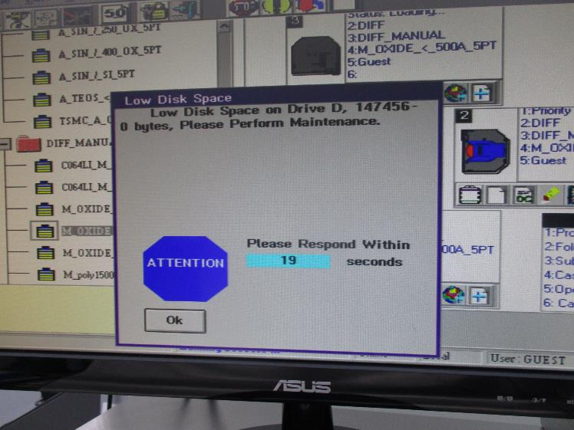
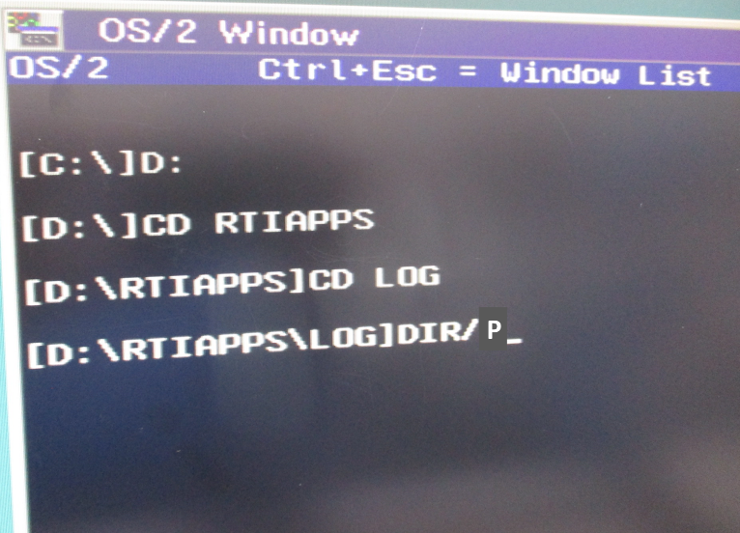
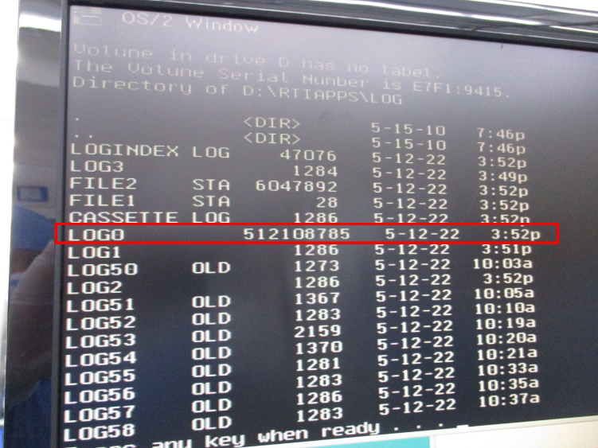
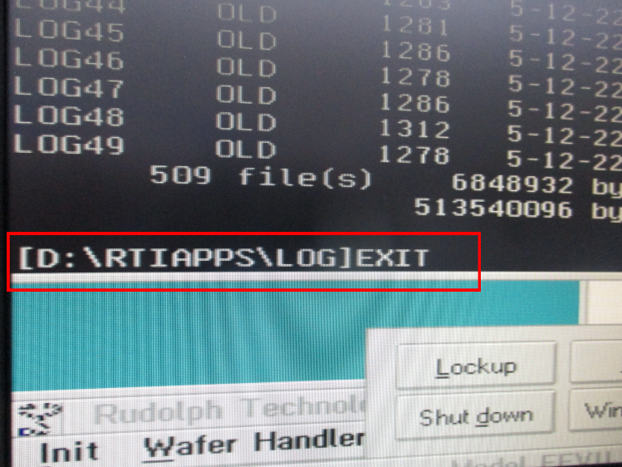
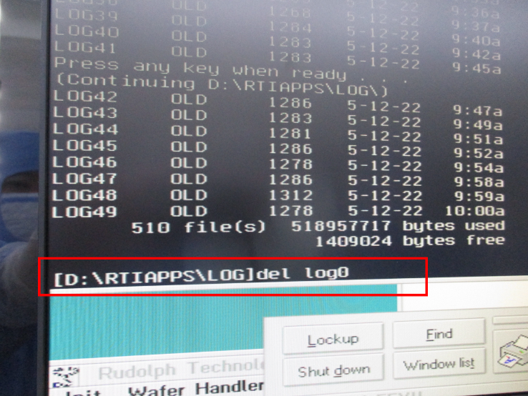
EM-5 刪除 H.D DATA LOG

Slide 3
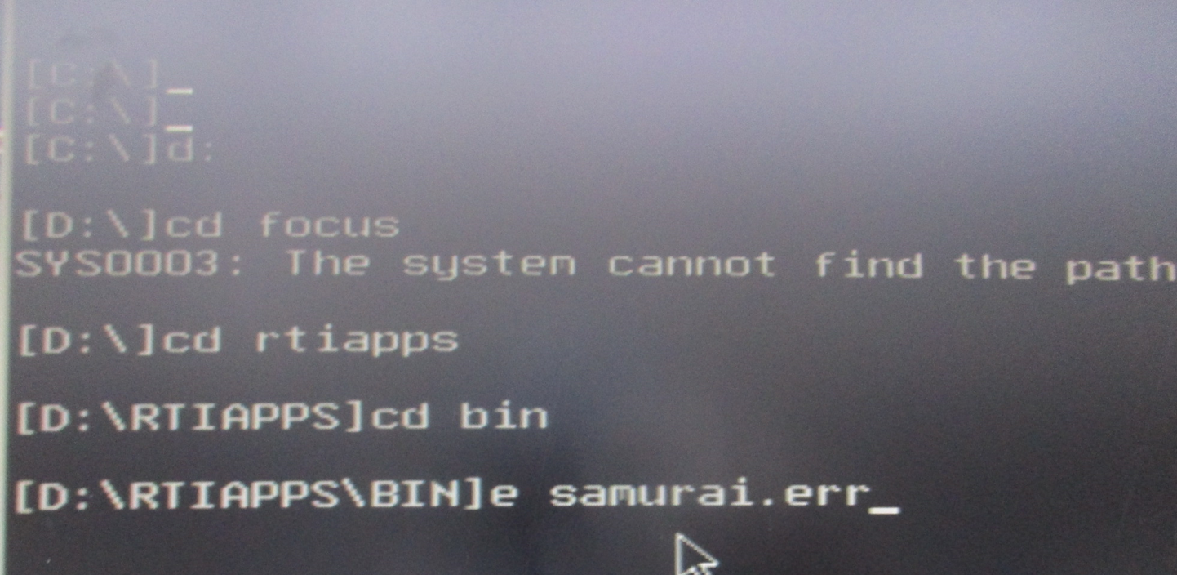
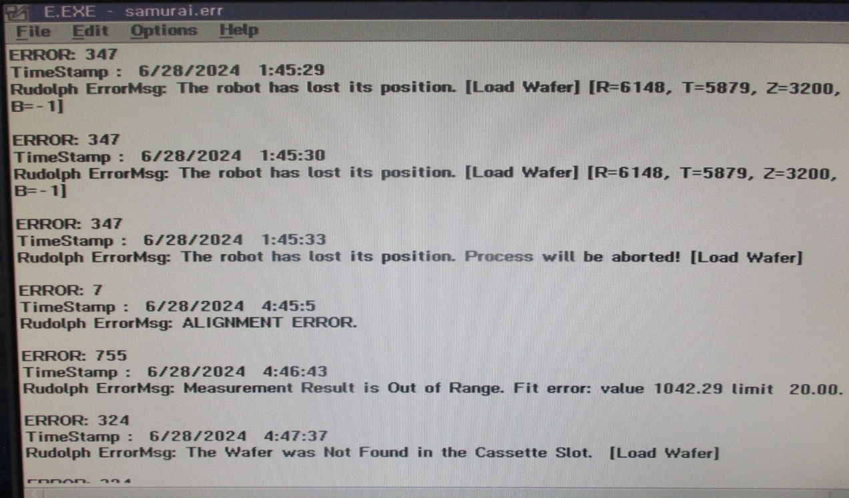
EM-5 查詢 Alarm error LOG

